Slide 1
Data Analytics – Lesson 11 Latent Dirichlet Allocation
Jeffrey Strickland, Ph.D., CMSP, ASEP
CEO Humalytica Analytics

Slide 2
Topic Analysis using Latent Dirichlet Allocation
Topic modeling focuses on the problem of classifying sets of documents into themes, either manually or automatically (preferred).
Topic modeling is a way of identifying patterns in a corpus—technically, this is text mining.
We take our corpus and group words across the corpus into ‘topics,’ using a text mining algorithm or tool.
A method for finding and tracing clusters of words (called “topics”)in large bodies of texts” (Posner 2012).
Specialized text mining
Involves words and phrases
Word clustering (Posner 2012)
Results in themes and topics
Probability of occurrence
R package – topicmodels (Grün and Hornik 2011)

Slide 3
Motivation
Classifying text data is a common task in machine learning
Suppose we were given a large volume of manuscripts and ask to organize them by topic or theme
The manuscripts comprise a collection of pre-Christian writings that arose in Alexandria, Egypt, around 300 B.C.
The manuscripts are written in Greek but have been translated to English
The client would like the manuscripts organized by these themes:
Prophecy
History
Law
Poetry
Government

Slide 4
Parallel Greek and English - Septuigent
And the Lord sent Nathan the prophet to David; and he went in to him, and said to him, there were two men in one city, one rich and the other poor. And the rich man had very many flocks and herds. But the poor man had only one little ewe lamb, which he had purchased, and preserved, and reared; an it grew up with himself and his children in common; it ate of his bread and drank of his cup, and slept in his bosom, and was to him as a daughter. And a traveler came to the rich man, and he spared to take of his flocks and of his herds, to dress for the traveler that came to him; and he took the poor man’s lamb, and dressed it for the man that came to him. And David was greatly moved with anger against the man; and David said to Nathan, As the Lord lives, the man that did this thing shall surely die. And he shall restore the lamb seven-fold, because he has not spared. And Nathan said to David, Thou art the man that has done this.
καὶ ἀπέστειλεν κύριος τὸν Ναθαν τὸν προφήτην πρὸς Δαυιδ καὶ εἰσῆλθεν πρὸς αὐτὸν καὶ εἶπεν αὐτῷ δύο ἦσαν ἄνδρες ἐν πόλει μιᾷ εἷς πλούσιος καὶ εἷς πένης καὶ τῷ πλουσίῳ ἦν ποίμνια καὶ βουκόλια πολλὰ σφόδρα καὶ τῷ πένητι οὐδὲν ἀλλ᾽ ἢ ἀμνὰς μία μικρά ἣν ἐκτήσατο καὶ περιεποιήσατο καὶ ἐξέθρεψεν αὐτήν καὶ ἡδρύνθη μετ᾽ αὐτοῦ καὶ μετὰ τῶν υἱῶν αὐτοῦ ἐπὶ τὸ αὐτό ἐκ τοῦ ἄρτου αὐτοῦ ἤσθιεν καὶ ἐκ τοῦ ποτηρίου αὐτοῦ ἔπινεν καὶ ἐν τῷ κόλπῳ αὐτοῦ ἐκάθευδεν καὶ ἦν αὐτῷ ὡς θυγάτηρ καὶ ἦλθεν πάροδος τῷ ἀνδρὶ τῷ πλουσίῳ καὶ ἐφείσατο λαβεῖν ἐκ τῶν ποιμνίων αὐτοῦ καὶ ἐκ τῶν βουκολίων αὐτοῦ τοῦ ποιῆσαι τῷ ξένῳ ὁδοιπόρῳ ἐλθόντι πρὸς αὐτὸν καὶ ἔλαβεν τὴν ἀμνάδα τοῦ πένητος καὶ ἐποίησεν αὐτὴν τῷ ἀνδρὶ τῷ ἐλθόντι πρὸς αὐτόν καὶ ἐθυμώθη ὀργῇ Δαυιδ σφόδρα τῷ ἀνδρί καὶ εἶπεν Δαυιδ πρὸς Ναθαν ζῇ κύριος ὅτι υἱὸς θανάτου ὁ ἀνὴρ ὁ ποιήσας τοῦτο καὶ τὴν ἀμνάδα ἀποτείσει ἑπταπλασίονα ἀνθ᾽ ὧν ὅτι ἐποίησεν τὸ ῥῆμα τοῦτο καὶ περὶ οὗ οὐκ ἐφείσατο καὶ εἶπεν Ναθαν πρὸς Δαυιδ σὺ εἶ ὁ ἀνὴρ ὁ ποιήσας τοῦτο τάδε λέγει κύριος ὁ θεὸς Ισραηλ ἐγώ εἰμι ἔχρισά σε εἰς βασιλέα ἐπὶ Ισραηλ καὶ ἐγώ εἰμι ἐρρυσάμην σε ἐκ χειρὸς Σαουλ

Slide 5
Latent Dirichlet Allocation (LDA) Model
In natural language processing, latent Dirichlet allocation (LDA) is a generative statistical model that allows sets of observations to be explained by unobserved groups that explain why some parts of the data are similar
A topic model which discovers underlying topics in a collection of documents and infers word probabilities in topics
If fit using a bag-of-n-grams then R treats the n-grams as individual words.

Slide 6

Introduction to Latent Dirichlet Allocation (LDA)
Suppose you have the following set of sentences extracted from P&C incoming calls:
I want to add a new vehicle to my policy.
I need to record a new VIN on my policy.
My daughter had an accident last night.
My daughter’s car was totaled, so we need to buy a new car.
How much will my policy premium go up if my daughter has an accident.
LDA represents documents as mixtures of topics that spit out words with certain probabilities
Decide on the number of words $w_{i}$= N the document will have (say, according to a Poisson distribution).
Choose a topic mixture for the document (according to a Dirichlet distribution over a fixed set of K topics).
Generate each word $w_{i}$ in the document by:
First picking a topic (according to the multinomial distribution that you sampled above)
Using the topic to generate the word itself (according to the topic’s multinomial distribution)
Assuming this generative model for a collection of documents, LDA then tries to backtrack from the documents to find a set of topics that are likely to have generated the collection.

Slide 7
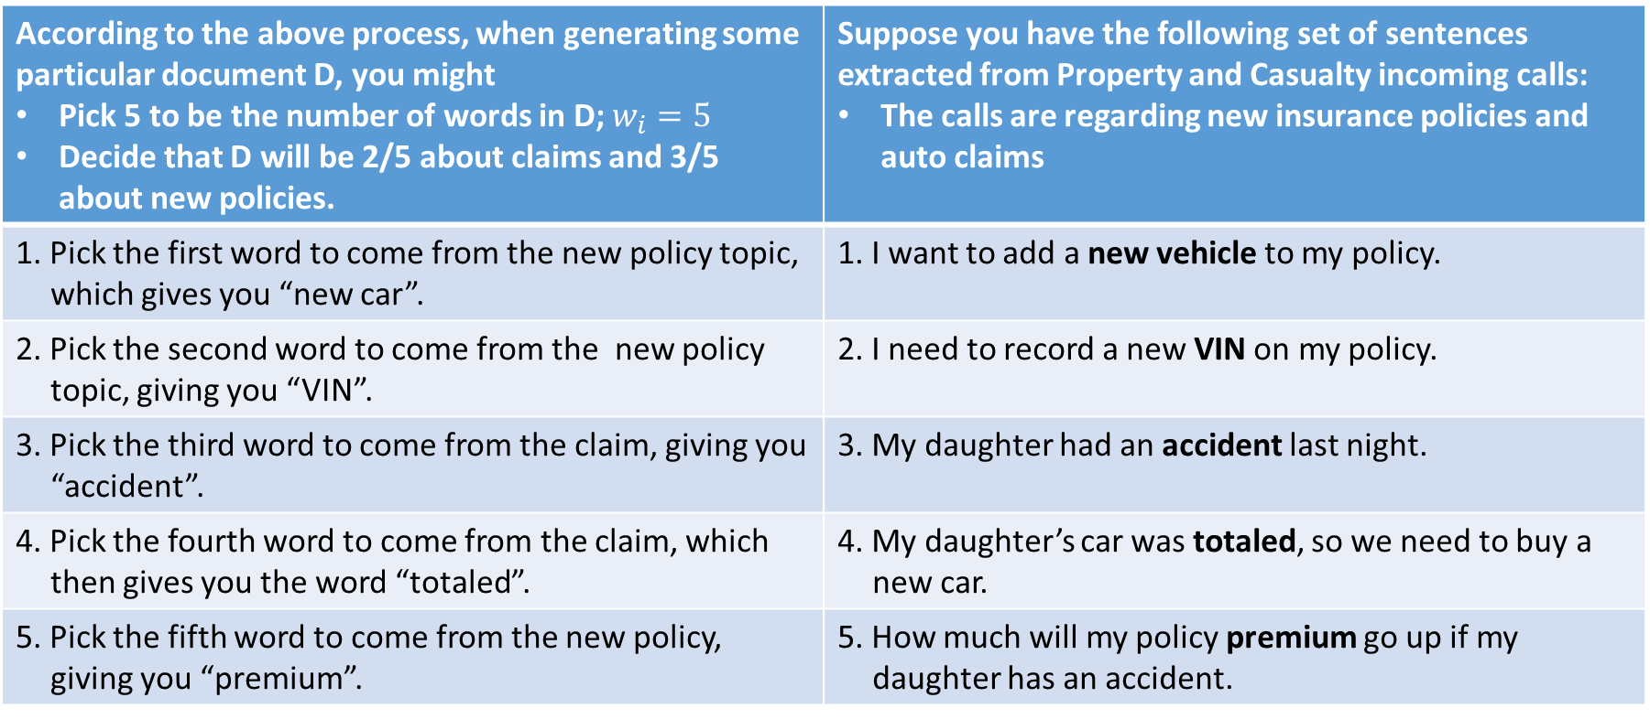
LDA Example
According to the above process, when generating some particular document D, you might Pick 5 to be the number of words in D; $w_{i}=5$ Decide that D will be 2/5 about claims and 3/5 about new policies. | Suppose you have the following set of sentences extracted from Property and Casualty incoming calls: The calls are regarding new insurance policies and auto claims
1. Pick the first word to come from the new policy topic, which gives you “new car”. | 1. I want to add a new vehicle to my policy.
2. Pick the second word to come from the new policy topic, giving you “VIN”. | 2. I need to record a new VIN on my policy.
3. Pick the third word to come from the claim, giving you “accident”. | 3. My daughter had an accident last night.
4. Pick the fourth word to come from the claim, which then gives you the word “totaled”. | 4. My daughter’s car was totaled, so we need to buy a new car.
5. Pick the fifth word to come from the new policy, giving you “premium”. | 5. How much will my policy premium go up if my daughter has an accident.

Slide 8

Learning
Our random guesses are very likely to be incorrect, so you want to improve on them. One way of doing so is to:
Pick a event and an product (e.g., an accident requires a claim)
Why does an accident likely lead to a claim? Can it lead to a new policy?
Keep analyzing events and product in this manner
In other words, the more events $E_{1}$ resulting in Claims, the more likely it is that a unique event results in a particular product.
Likewise, the more events $E_{2}$ resulting in New Policies, the more likely it is that a unique event results in a particular product.
So make a new guess as to why an accident results in a claim, choosing an interest with some probability according to how likely you think it is (an accident can also result in buying a new car and consequently a new policy).

Slide 9
Preprocessing
A document-term matrix or term-document matrix is a mathematical matrix that describes the frequency of terms that occur in a collection of documents.
In a document-term matrix, rows correspond to documents in the collection and columns correspond to terms.
I will use a collection of 20 posts from my LinkedIn blog as an example corpus
The corpus can be downloaded here.
I will assume that you have access to R and RStudio.

Slide 10
Preprocessing
#load text mining library
library(tm)
#set working directory (modify path as needed)
setwd(“C:/Users/Jeff/Documents/VIT_University”)
#load files into corpus
#get listing of .txt files in directory
filenames <- list.files(getwd(),pattern=”*.txt”)
#read files into a character vector
files <- lapply(filenames,readLines)
#create corpus from vector
docs <- Corpus(VectorSource(files))
#inspect a particular document in corpus
writeLines(as.character(docs[[30]]))
#start preprocessing
#Transform to lower case
docs <-tm_map(docs,content_transformer(tolower))
#remove potentially problematic symbols
toSpace <- content_transformer(function(x, pattern) { return (gsub(pattern, ” “, x))})
docs <- tm_map(docs, toSpace, “-“)
docs <- tm_map(docs, toSpace, “’”)
docs <- tm_map(docs, toSpace, “‘”)
docs <- tm_map(docs, toSpace, “•”)
docs <- tm_map(docs, toSpace, “””)
docs <- tm_map(docs, toSpace, ““”)

Slide 11
Preprocessing
#remove punctuation
docs <- tm_map(docs, removePunctuation)
#Strip digits
docs <- tm_map(docs, removeNumbers)
#remove stopwords
docs <- tm_map(docs, removeWords, stopwords(“english”))
#remove whitespace
docs <- tm_map(docs, stripWhitespace)
#Good practice to check every now and then
writeLines(as.character(docs[[30]]))
#Stem document
docs <- tm_map(docs,stemDocument)
#fix up 1) differences between us and aussie english 2) general errors
docs <- tm_map(docs, content_transformer(gsub),
pattern = “organiz”, replacement = “organ”)
docs <- tm_map(docs, content_transformer(gsub),
pattern = “organis”, replacement = “organ”)
docs <- tm_map(docs, content_transformer(gsub),
pattern = “andgovern”, replacement = “govern”)
docs <- tm_map(docs, content_transformer(gsub),
pattern = “inenterpris”, replacement = “enterpris”)
docs <- tm_map(docs, content_transformer(gsub),
pattern = “team-“, replacement = “team”)

Slide 12
Svm in kernlab – Promotergene Data
#define and eliminate all custom stopwords
myStopwords <-c(“can”, “say”, ”one”, ”way”, ”use”, “also”, ”howev”, ”tell”, ”will”, “much”, ”need”, ”take”, ”tend”, ”even”, “like”, ”particular”, ”rather”, ”said”, “get”, ”well”, ”make”, ”ask”, ”come”, ”end”, “first”, ”two”, ”help”, ”often”, ”may”, “might”, ”see”, ”someth”, ”thing”, ”point”, “post”, ”look”, ”right”, ”now”, ”think”, ”‘ve“, “‘re“, ”anoth”, ”put”, ”set”, ”new”, ”good”, “want”, ”sure”, ”kind”, ”larg”, ”yes, ”, ”day”, ”etc”, “quit”, ”sinc”, ”attempt”, ”lack”, ”seen”, ”awar”, “littl”, ”ever”, ”moreov”, ”though”, ”found”, ”abl”, “enough”, ”far”, ”earli”, ”away”, ”achiev”, ”draw”, “last”, ”never”, ”brief”, ”bit”, ”entir”, ”brief”, “great”, ”lot”)
docs <- tm_map(docs, removeWords, myStopwords)
#inspect a document as a check
writeLines(as.character(docs[[30]]))
#Create document-term matrix
dtm <- DocumentTermMatrix(docs)
#convert rownames to filenames
rownames(dtm) <- filenames
#collapse matrix by summing over columns
freq <- colSums(as.matrix(dtm))

Slide 13
Preprocessing
#load topic models library
library(topicmodels)
#Set parameters for Gibbs sampling
burnin <- 4000
iter <- 2000
thin <- 500
seed <-list(2003,5,63,100001,765)
nstart <- 5
best <- TRUE
#Number of topics
k <- 5
Load data file
Load these files into a charcter vector
Load the vectors into a corpus
Transform to lower case
Remove potential problematic symbols
Remove punctuation
Remove stop words
Remove white space
Reconcile language difference
Set the number of topics, k = 5

Slide 14
Mine Data for Topics
#Run LDA using Gibbs sampling
ldaOut <-LDA(dtm,k, method=”Gibbs”, control=list(nstart=nstart, seed = seed, best=best, burnin = burnin, iter = iter, thin=thin))
#write out results
#docs to topics
ldaOut.topics <- as.matrix(topics(ldaOut))
write.csv(ldaOut.topics,file=paste(“LDAGibbs”,k,”DocsToTopics.csv”))
#top 6 terms in each topic
ldaOut.terms <- as.matrix(terms(ldaOut,6))
write.csv(ldaOut.terms,file=paste(“LDAGibbs”,k,”TopicsToTerms.csv”))
#probabilities associated with each topic assignment
topicProbabilities <- as.data.frame(ldaOut@gamma)
write.csv(topicProbabilities,file=paste(“LDAGibbs”,k,”TopicProbabilities.csv”))
#Find relative importance of top 2 topics
topic1ToTopic2 <- lapply(1:nrow(dtm),function(x)
sort(topicProbabilities[x,])[k]/sort(topicProbabilities[x,])[k-1])
#Find relative importance of second and third most important topics
topic2ToTopic3 <- lapply(1:nrow(dtm),function(x)
sort(topicProbabilities[x,])[k-1]/sort(topicProbabilities[x,])[k-2])
#write to file working directory
write.csv(topic1ToTopic2,file=paste(“LDAGibbs”,k,”Topic1ToTopic2.csv”))
write.csv(topic2ToTopic3,file=paste(“LDAGibbs”,k,”Topic2ToTopic3.csv”))

Slide 15
Results
The table below lists the top 6 terms in topics 1 through 5.
This and subsequent tables are written from the code into the working directory.
 | Topic 1 | Topic 2 | Topic 3 | Topic 4 | Topic 5
1 | tree | cluster | model | itemset | analyt
2 | classif | branch | event | support | data
3 | node | dendrogram | custom | sas | scientist
4 | variabl | member | distribut | candid | statist
5 | patient | leaf | probabl | text | user
6 | analysi | algorithm | predict | algorithm | provid

Slide 16
Topics
Topic 1: Classification Trees
Topic 2: Hierarchical Clustering
Topic 3: Predictive Models
Topic 4: Text Analytics
Topic 5: Data Scientists
Five Topics
 | Topic 1 | Topic 2 | Topic 3 | Topic 4 | Topic 5
1 | tree | cluster | model | itemset | analyt
2 | classif | branch | event | support | data
3 | node | dendrogram | custom | sas | scientist
4 | variabl | member | distribut | candid | statist
5 | patient | leaf | probabl | text | user
6 | analysi | algorithm | predict | algorithm | provid
Top Six Words

Slide 17
Svm in e1071 – Predict
Document | Topic
10 More Signs that might be a Data you Scientist.txt | 5
10 Signs that might be a Data you Scientist.txt | 5
4 Types of Analytics Users and How to Sell to Them.txt | 5
A one-eyed man in the kingdom of the blind.txt | 3
All Things Data.txt | 5
Analytics and Statistics.txt | 5
Analytics is it more than a buzzword.txt | 5
Bayesian networks.txt | 1
Big Data Analytics and Human Resources.txt | 5
Big Data The Good the Bad and the Ugly.txt | 5
Document | Topic
Call Center Analytics.txt | 3
Classification Trees using R.txt | 1
Clouds clouds and more clouds.txt | 4
Cluster Models.txt | 2
Cyber-Threat Risk Assessment using R.txt | 3
Data Scientist are Dead Long Live Data Science.txt | 5
Do you like my Ensemble.txt | 3
Free SAS.txt | 4
Getting the Question Right.txt | 5
What are Association Rules in Analytics.txt | 4
Topic 1: Classification Trees
Topic 2: Hierarchical Clustering
Topic 3: Predictive Models
Topic 4: Text Analytics
Topic 5: Data Scientists

Slide 18
Results
 | Topic 1 | Topic 2 | Topic 3 | Topic 4 | Topic 5
1 | 0.095694 | 0.086124 | 0.248804 | 0.129187 | 0.440191
2 | 0.12 | 0.12 | 0.176 | 0.148 | 0.436
3 | 0.038534 | 0.025376 | 0.065789 | 0.055451 | 0.81485
4 | 0.089124 | 0.033233 | 0.620846 | 0.049849 | 0.206949
5 | 0.069079 | 0.046053 | 0.190789 | 0.078947 | 0.615132
6 | 0.090226 | 0.114662 | 0.360902 | 0.048872 | 0.385338
7 | 0.111511 | 0.048561 | 0.214029 | 0.091727 | 0.534173
8 | 0.743056 | 0.054167 | 0.122222 | 0.045833 | 0.034722
9 | 0.079646 | 0.033186 | 0.097345 | 0.081858 | 0.707965
10 | 0.078098 | 0.056027 | 0.174873 | 0.171477 | 0.519525
11 | 0.072 | 0.093333 | 0.672 | 0.053333 | 0.109333
12 | 0.833835 | 0.034919 | 0.045756 | 0.033113 | 0.052378
13 | 0.056 | 0.052 | 0.104 | 0.586667 | 0.201333
14 | 0.046584 | 0.866977 | 0.02588 | 0.017081 | 0.043478
15 | 0.126582 | 0.049051 | 0.762658 | 0.036392 | 0.025316
16 | 0.137681 | 0.072464 | 0.115942 | 0.068841 | 0.605072
17 | 0.192529 | 0.068966 | 0.520115 | 0.071839 | 0.146552
18 | 0.068063 | 0.029668 | 0.113438 | 0.532286 | 0.256545
19 | 0.094771 | 0.078431 | 0.25817 | 0.062092 | 0.506536
20 | 0.043868 | 0.048853 | 0.032901 | 0.840479 | 0.033898
In the table, the highest probability in each row is in bold.
Also, in cases where the maximum and the second largest probabilities are close, I have highlighted the second highest probabilities in red.
It is clear that “Analytics is it more than a in the above table) has 2 topics with comparable probabilities – topic 1 (data scientists) and topic 2 (data models), in decreasing order of probabilities.
A reading of Document 1,2 “Classification trees using R,” has a 83% chance of being about Topic : 1 classification tree.

Slide 19
Limitations
When searching for a number of iterations to achieve an optimal solution, LDA only guarantees a local maximum
That is, LDA does not necessarily find a global solution
The more complex you make the LDA, the longer it takes to find a solution
Occam’s Razor: Make it as simple as possible but not too simple

Slide 20
Example: Presidential Debate
2012 Presidential Debate
The bipartisan Commission on Presidential Debates (CPD) held four debates for the 2012 U.S. presidential general election
Presidential nominees
Democratic President Barack Obama from Illinois
former Republican Governor Mitt Romney of Massachusetts

Slide 21
PRELIMINARIES
Libraries needed for data processing and plotting:
setwd("C:/Users/jeff/Documents/VIT_University") ## Install/Load Tools & Data library(scales) library(Rcpp) library(tm) library(topicmodels) library(dplyr) library(tidyr) library(igraph) library(devtools) library(LDAvis) library(ggplot2) library(sentimentr)

Slide 22
Get External Scripts
Source external script with my own handy functions definitions:
> source(“data/my_defs.R”)
The content of this external file is included in the Appendix at the end of this report.

Slide 23
Generate Stopwords
Stop words are basically a set of commonly used words in any language, not just English.
The reason why stop words are critical to many applications is that, if we remove the words that are very commonly used in a given language, we can focus on the important words instead.
> stops <- c( tm::stopwords(“english”),
tm::stopwords(“SMART”),
“governor”, “president”, “mister”, “obama”,“romney” )
%>% gofastr::prep_stopwords()

Slide 24
Create the DocumentTermMatrix
In a document-term matrix, rows correspond to documents in the collection and columns correspond to terms.
> doc_term_mat <- presidential_debates_2012 %>%
with(gofastr::q_dtm_stem(dialogue, paste(person, time, sep = "_")))
%>% gofastr::remove_stopwords(stops, stem=TRUE)
%>% gofastr::filter_tf_idf() %>% gofastr::filter_documents()

Slide 25
Determine Optimal Number of Topics
In order to perform the subsequent steps of the analysis, the text had to be put in to a document term matrix, since optimization is a mathematical function
> control <- list(burnin = 500, iter = 1000, keep = 100)
> (k <- optimal_k(doc_term_mat, 40, control = control))
[1] 15

Slide 26
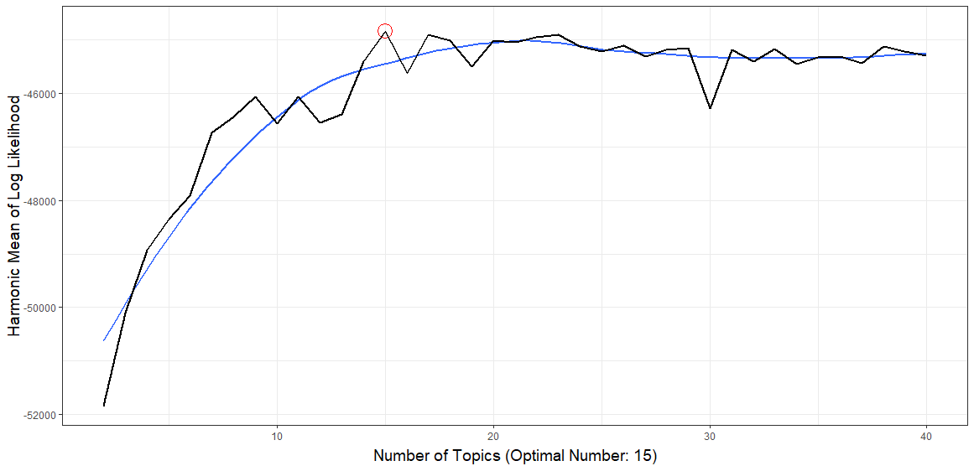
Harmonic Mean of Log Likelihood Method
Optimal Number of Topics = 15

Slide 27
Latent Dirichlet Allocation (LDA) Model
In natural language processing, latent Dirichlet allocation (LDA) is a generative statistical model that allows sets of observations to be explained by unobserved groups that explain why some parts of the data are similar
A topic model which discovers underlying topics in a collection of documents and infers word probabilities in topics
If fit using a bag-of-n-grams then R treats the n-grams as individual words.

Slide 28
Fit the LDA Model
> control[[“seed”]] <- 100
> lda_model <- topicmodels::LDA(doc_term_mat, k=as.numeric(k),
method = “Gibbs”, control = control)
10 of 40 iterations (Current: 10:38:55; Elapsed: .1 mins)
20 of 40 iterations (Current: 10:39:09; Elapsed: .3 mins; Remaining: ~.9 mins)
30 of 40 iterations (Current: 10:39:29; Elapsed: .7 mins; Remaining: ~.5 mins)
40 of 40 iterations (Current: 10:39:57; Elapsed: 1.1 mins; Remaining: ~0 mins)
Optimal number of topics = 15

Slide 29
Plot the Topics Per Person & Time
> topics <- topicmodels::posterior(lda_model, doc_term_mat)[[“topics”]]
> topic_dat <- dplyr::add_rownames(as.data.frame(topics), “Person_Time”)
> colnames(topic_dat)[-1] <- apply(terms(lda_model,10), 2, paste, collapse = “,”)
> tidyr::gather(topic_dat, Topic, Proportion, -c(Person_Time)) %>%
tidyr::separate(Person_Time, c(“Person”, “Time”), sep = "_“) %>%
dplyr::mutate(Person = factor(Person, levels =
c(”OBAMA“,”ROMNEY“,”LEHRER“,”SCHIEFFER“,”CROWLEY“,”QUESTION" ))) %>%
ggplot2::ggplot(ggplot2::aes(weight=Proportion, x=Topic, fill=Topic)) +
ggplot2::geom_bar() +
ggplot2::coord_flip() +
ggplot2::facet_grid(Person~Time) +
ggplot2::guides(fill=FALSE) +
ggplot2::xlab(“Proportion”)

Slide 30
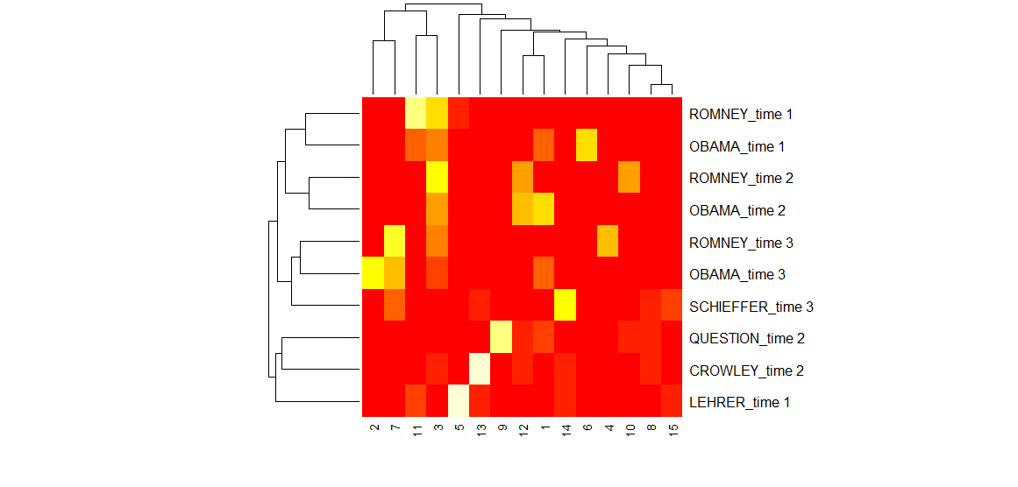
Heatmap of Topics
Topics by Candidate

Slide 31
Network of the Word Distributions Over Topics
>post <- topicmodels::posterior(lda_model)
> cor_mat <- cor(t(post[[“terms”]])) cor_mat[ cor_mat < .05 ] <- 0
> diag(cor_mat) <- 0
> graph <- graph.adjacency(cor_mat, weighted=TRUE, mode=“lower”)
> graph <- delete.edges(graph, E(graph)[ weight < 0.05])
> E(graph)𝑒𝑑𝑔𝑒.𝑤𝑖𝑑𝑡ℎ<−𝐸(𝑔𝑟𝑎𝑝ℎ)weight20
> V(graph)$label <- paste("Topic", V(graph))
> V(graph)$size <- colSums(post[[“topics”]]) 15
> par(mar=c(0, 0, 3, 0)); set.seed(110)
> plot.igraph(graph, edge.width = E(graph)$edge.width, edge.color = “orange”,
vertex.color = “orange”, vertex.frame.color = NA,
vertex.label.color = “grey30”)
title(“Strength Between Topics Based On Word Probabilities”, cex.main=.8)

Slide 32
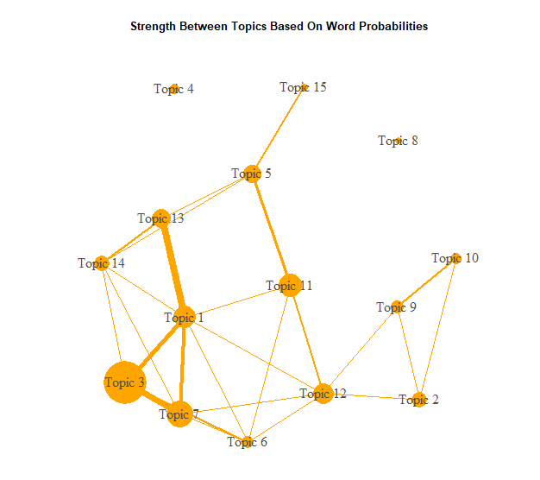
Word Distributions over Topics
Topics by Candidate

Slide 33
Network of the Topics Over Documents
> minval <- .1 #topic_mat <- topicmodels::posterior(lda_model)[[“topics”]]
> graph <- graph_from_incidence_matrix(topic_mat, weighted=TRUE)
> graph <- delete.edges(graph, E(graph)[ weight < minval])
> E(graph)edge.width<−𝐸(𝑔𝑟𝑎𝑝ℎ)weight*17 E(graph)$color <- "blue"
> V(graph)$color <- ifelse(grepl(“^\d+$", V(graph)$name),”grey75“,”orange“)
> V(graph)frame.color<−NAV(graph)label <- ifelse(grepl(”^\d+$",
> V(graph)$name), paste(“topic”, V(graph)$name), gsub("_", "\n", V(graph)$name))
> V(graph)size<−c(rep(10,nrow(topic_m at)),colSums(topic_m at)∗20)V(graph)
> label.color <- ifelse(grepl(“^\d+$", V(graph)$name),”red“,”grey30")
> par(mar=c(0, 0, 3, 0)); set.seed(365)
> plot.igraph(graph, edge.width = E(graph)
edge.width, vertex.color=adjustcolor(V(graph)color, alpha.f = .4))
title(“Topic & Document Relationships”, cex.main=.8)

Slide 34
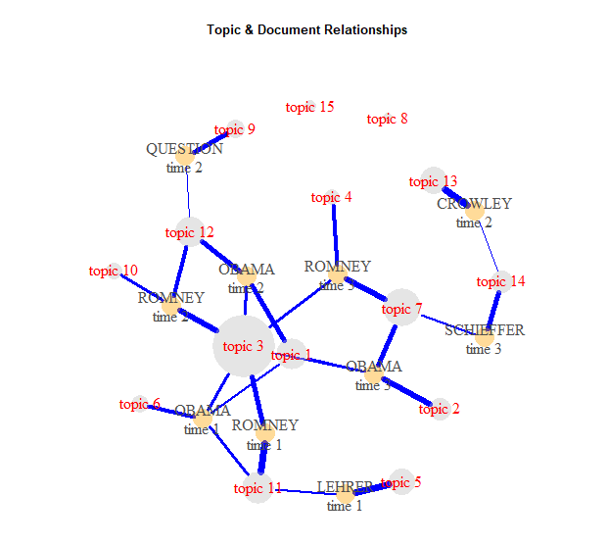
Word Topics over Documents
Topics by Candidate

Slide 35
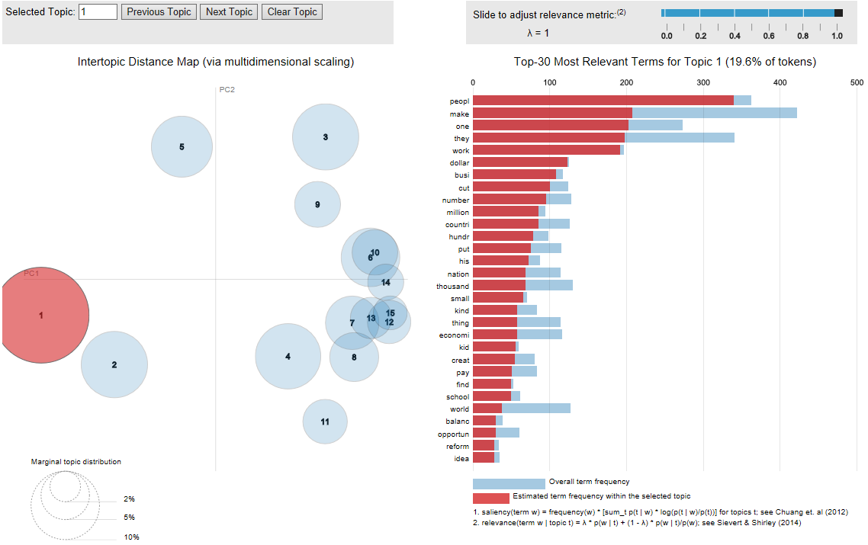
Intertopic Distance Map (HTML)
Topic 1 with Relative Terms

Slide 36
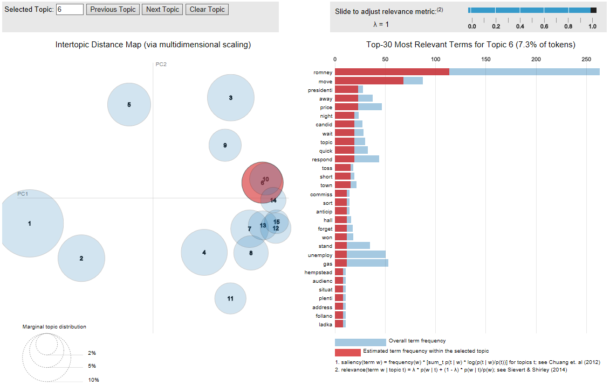
Intertopic Distance Map
Topic 6 with Relative Terms

Slide 37
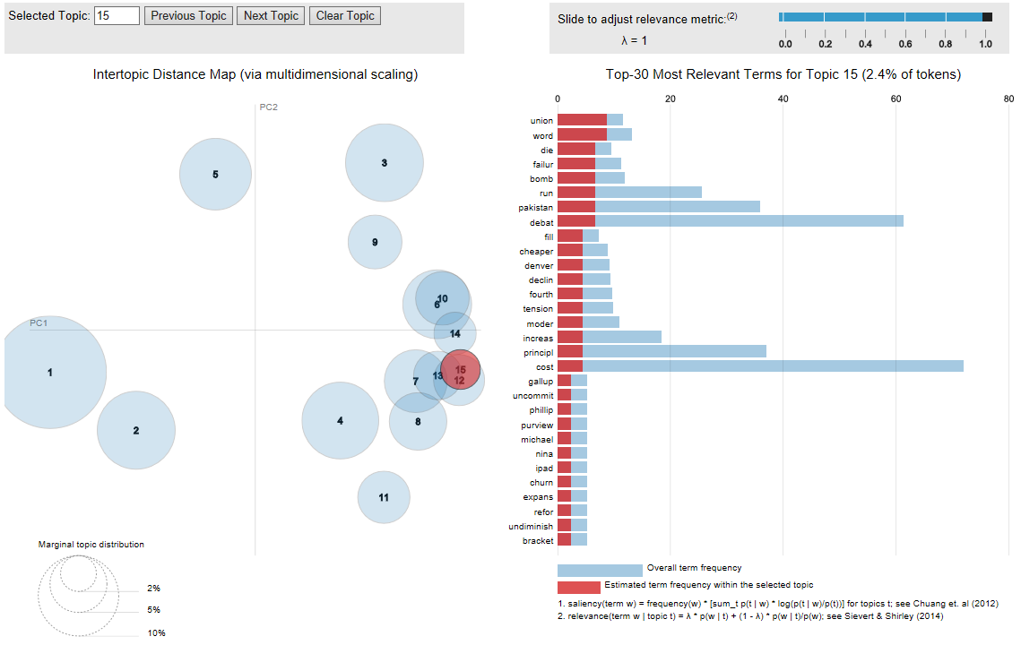
Intertopic Distance Map
Topic 15 with Relative Terms

Slide 38
Fitting New Data
> library(gofastr) ## Create the DocumentTermMatrix for New Data
> doc_term_mat2 <- partial_republican_debates_2015 %>%
with(gofastr::q_dtm_stem(dialogue, paste(person, location, sep = "_")))
%>% gofastr::remove_stopwords(stops, stem=TRUE)
%>% gofastr::filter_tf_idf() %>% gofastr::filter_documents()

Slide 39
Fit a Model for New Data
> control2 <- control control2[[“estimate.beta”]] <- FALSE
> lda_model2 <- topicmodels::LDA(doc_term_mat2, k = as.numeric(k),
model = lda_model, control = control2)

Slide 40
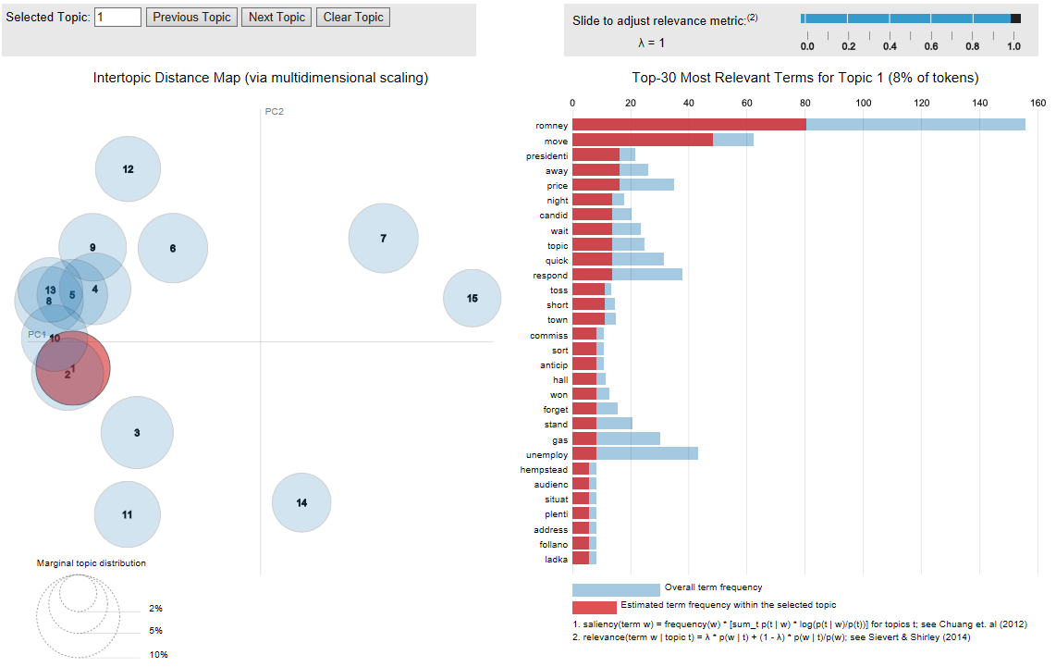
New Model Intertopic Distance Map
Topic 1 with Relative Terms

Slide 41
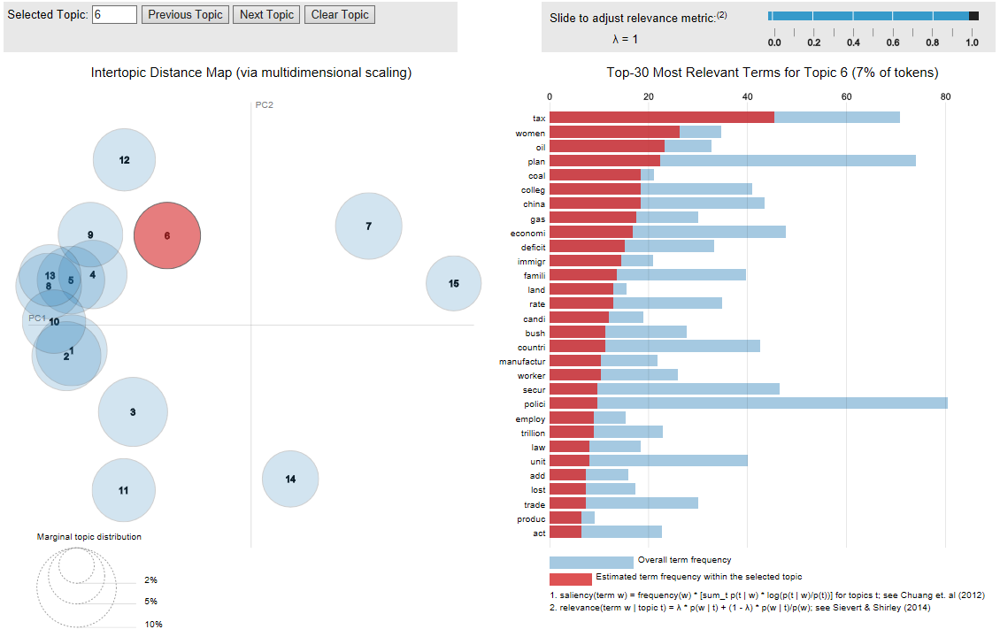
New Model Intertopic Distance Map
Topic 6 with Relative Terms

Slide 42
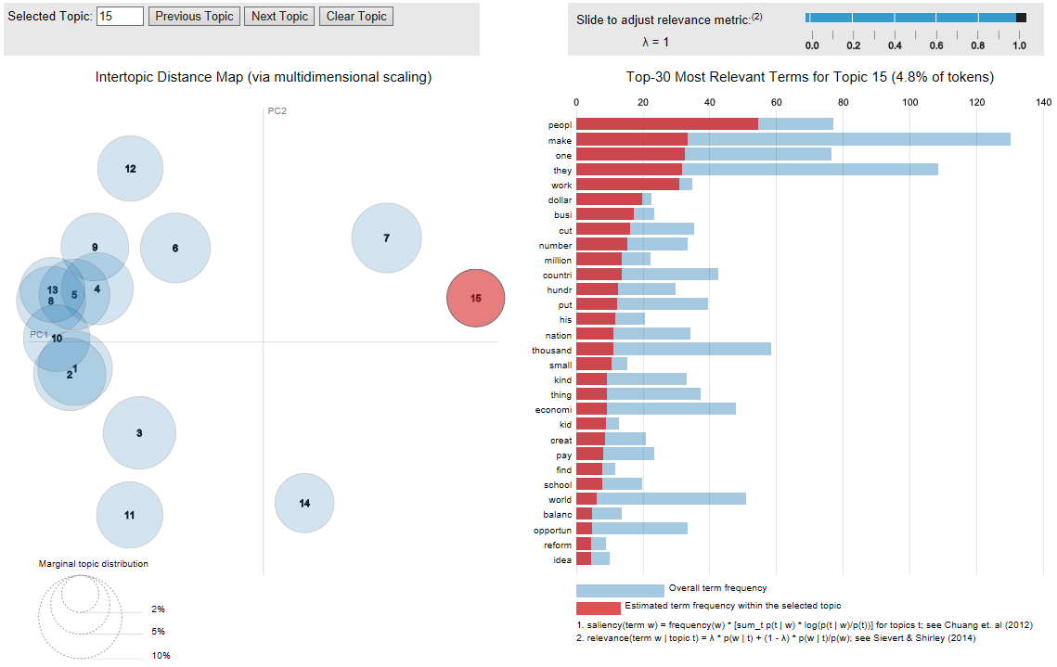
New Model Intertopic Distance Map
Topic 15 with Relative Terms

Slide 43
LDAvis of Model for New Data
Places the Plots into your web browser
> lda_model2 %>% topicmodels2LDAvis() %>% LDAvis::serVis()

Slide 44
www.humalytica.com
http://www.amazon.com/Jeffrey-Strickland/e/B00IQ69QZK/
http://www.lulu.com/spotlight/strickland_jeffrey

